Slide 1
Finance for Non-Finance
M S Narasimhan
Indian Institute of Management Bangalore

Slide 2
Agenda
How to draw meaningful inferences from financial statements?
How do we manage cost and ensure cost-efficiency?
How do we take financial decisions?

Slide 3
Financial Statements
Balance Sheet
  Assets = Liabilities + Equity + Revenue - Expenses
Income Statement
  Subset of Balance sheet
  Income – Expenses = Profit
  Gross Profit, EBDITA, PBIT, PBT, PAT or Net Profit
Cash Flow Statement
  Cash generated through (a) Operations (b) Financing activities and (c) Investing activities

Slide 4
Balance Sheet of UHGIS
 | Mar-13 | Mar-12
Shareholders Fund | 3984.79 | 3022.19
Long-term Provisions | 409.47 | 266.62
Total Current Liabilities | 1467.47 | 699.25
Total Sources of Funds | 5861.73 | 3988.06
Total Fixed Assets | 2210.55 | 1310.06
Total Current Assets | 3651.18 | 2678.00
Total Uses of Funds | 5861.73 | 3988.06

Slide 5
Income Statement of UHGIS
 | Mar-13 | Mar-12
Revenue from Operations | 8990.87 | 6325.64
Other Income | 120.98 | 160.40
Total Income | 9111.85 | 6486.04
Employee Benefit | 5092.23 | 3606.48
Depreciation | 423.32 | 379.37
Other Expenses | 2480.67 | 1717.75
Total Expenses | 7996.22 | 5703.60
Profit before Taxes | 1115.63 | 782.44
Taxes | 153.03 | 121.73
Profit after Taxes | 962.60 | 660.71

Slide 6
Understanding Profit Drivers
How do we assess the performance of a business?
  ROI ? ROE ?
What drives ROE?
  Asset Management
  Cost or Profit Management
  Leverage or Debt Management
  Tax Management

Slide 7
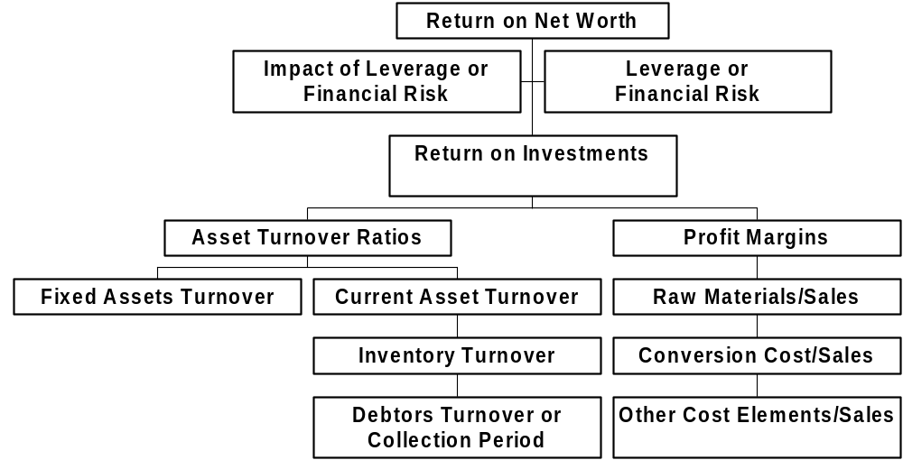
FSA-Basic Structure

Slide 8
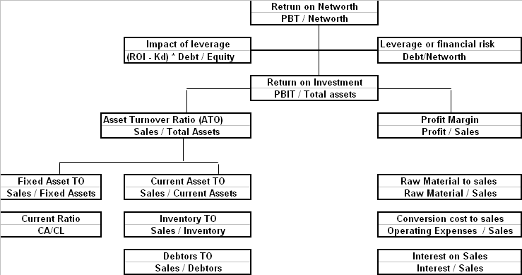
DuPont Chart

Slide 9
FSA of L&T Ltd.
2000 2001
Net Worth 3864 3999
Loan 3974 4263
Total 7838 8263
F.A. 4589 4671
Inventory 2112 2537
Receivables 2343 2648
Cash 1081 1008
Less: C.L. 2287 2601
Total Assets 7838 8263
2000 2001
Sales 7125 7633
Raw Material 1681 1807
Op. Expenses 4564 4936
PBIT 880 890
Interest 498 551
PBT 382 339
Tax 41 24
PAT 341 315
What went wrong in 2001?

Slide 10
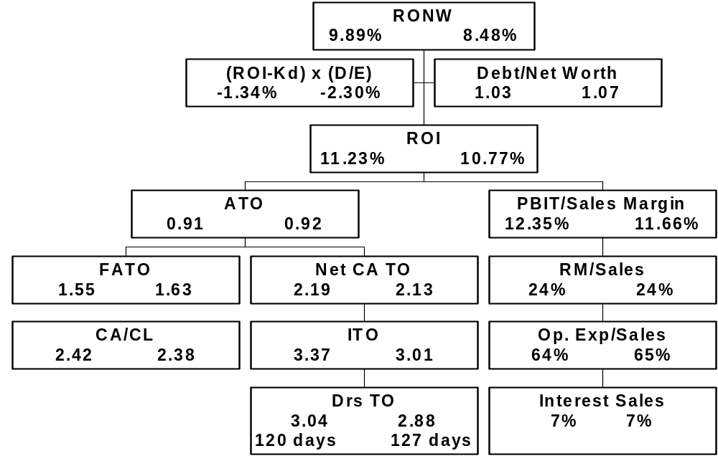
FSA- L&T Ltd.

Slide 11
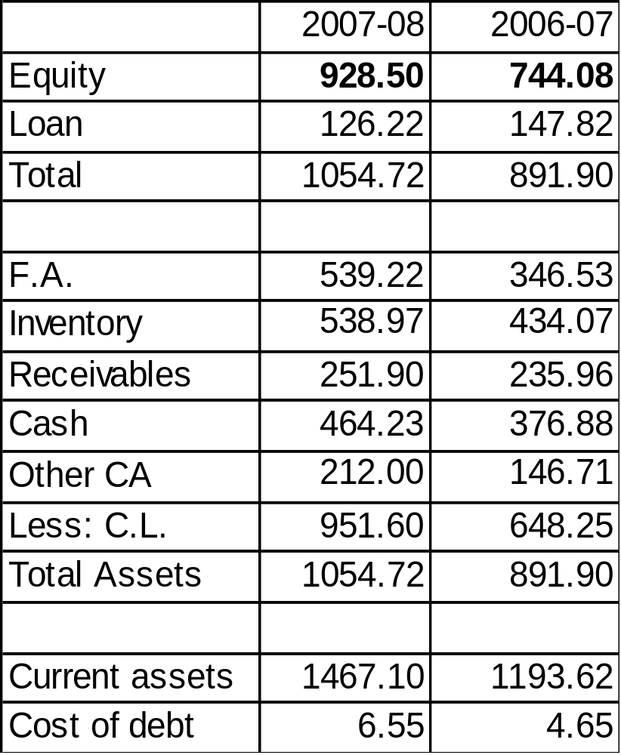
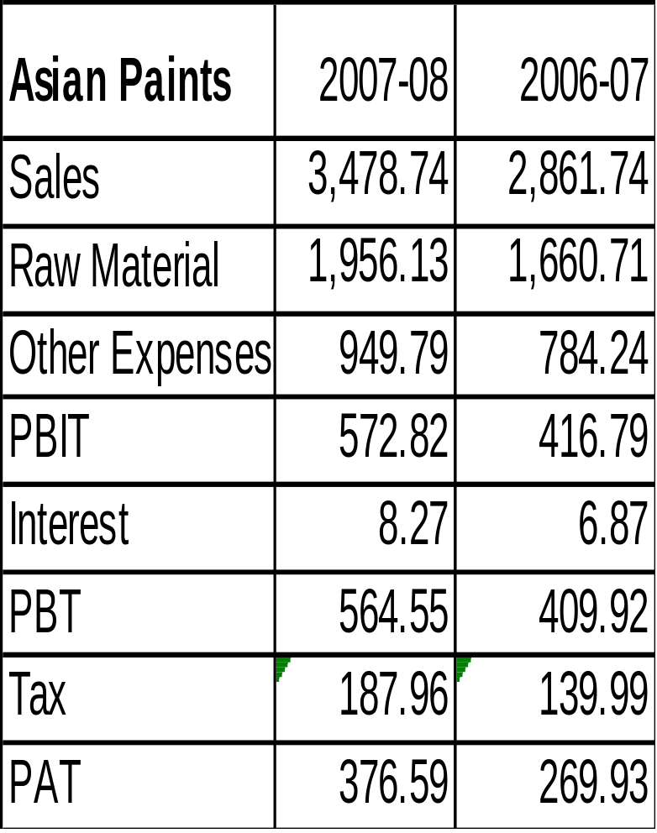
FSA of Asian Paints Ltd.

Slide 12
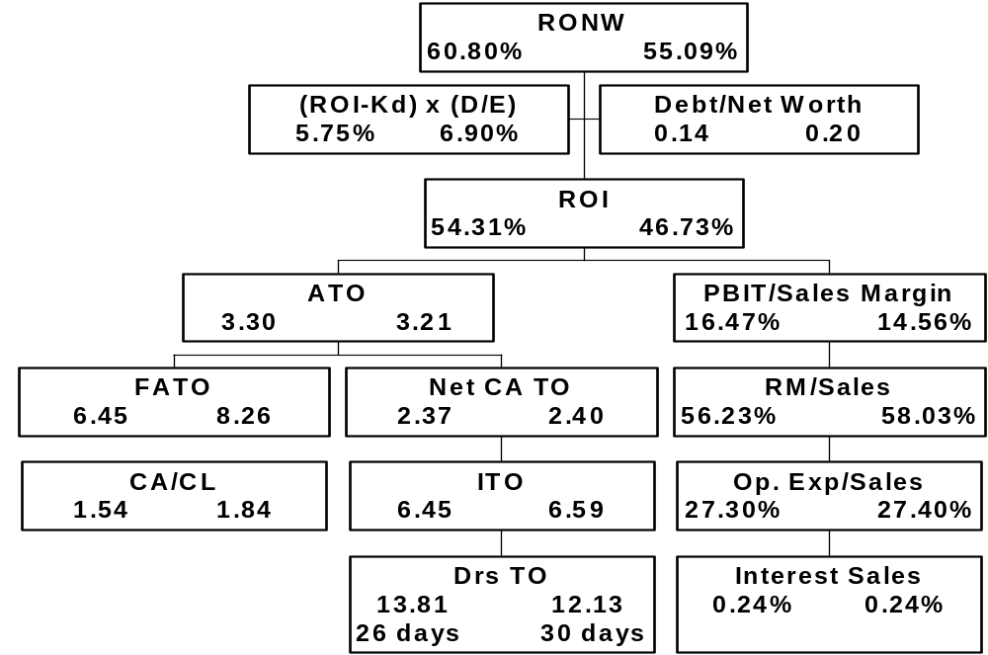
FSA- Asian Paints

Slide 13
FSA of Asian Paints Ltd.
Profitability increased on account of both better cost management and asset management
  Raw material consumption declined
Scope for improvement
  Fixed Asset Turnover ratio declined – why?
  Inventory Turnover ratio declined – why?

Slide 14
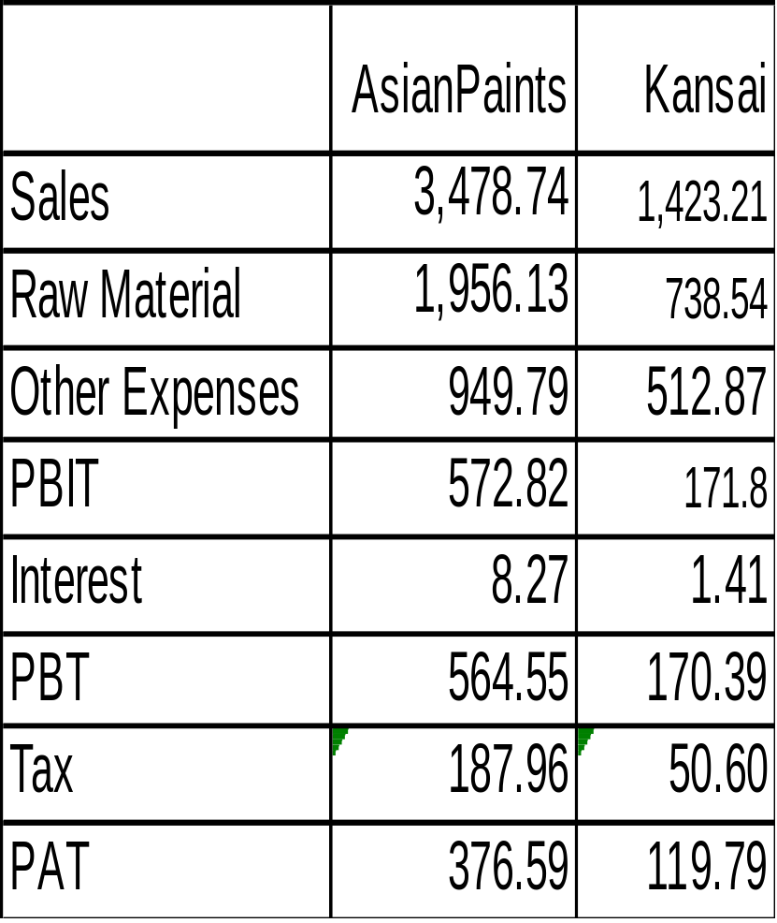
Asian Paints vs. Kansai Nerolac
 | Asian Paints | Kansai
Equity | 928.50 | 593.69
Loan | 126.22 | 97.95
Total Liabilities | 1054.72 | 691.64
F.A. | 539.22 | 233.84
Inventory | 538.97 | 173.41
Receivables | 251.90 | 212.93
Cash | 464.23 | 265.52
Other CA | 212.00 | 58.53
Less: C.L. | 951.60 | 252.59
Total Assets | 1054.72 | 691.64
Current assets | 1467.1 | 710.39
Cost of debt | 6.55 | 1.44

Slide 15

FSA- Asian Paints vs. Kansai

Slide 16
Asian Paints vs. Kansai Nerolac
What are the areas of improvement that Kansai should take-up?
  Kansai is not doing well both on Asset management and cost management
  Operating expenses are high
  On the assets side, receivable management requires improvement

Slide 17
Altman’s Credit Rating Model
Z = 1.2 x1 + 1.4 x2 + 3.3 x3 + 0.6 x4 + 1.0 x5
Where: x1 = Working Capital/Total Assets
x2 = Retained Earnings/Total Assets
x3 = EBIT/Total Assets
x4 = Equity/Total Debt
x5 = Sales/Total Assets
If Z is below 2.675, then the firm is potentially a sick firm.
E.I.Altman, Financial Ratios, Discriminant Analysis, and Prediction of Corporate Bankkruptcy, JOF, Sept. 1968, 581-609

Slide 18
Summary: Financial Statements
Financial Statements are analyzed in different ways to get further insight on the activities of the business unit
Major methods of analysis are Horizontal, Trend and ratio analysis
FS are analysed to know
  Profit and profitability
  Performance of Different Functions
  Long-term and Short-term Solvency or Liquidity

Slide 19
Cost Analysis and Management

Slide 20
Classification of Costs
Two broad classification
  Variable Cost
  Fixed cost
  Costs are often mixed
Cost of employees who are directly involved in operations are variable cost
Most other costs are fixed in the short run and are “step costs”
A small part of total cost are fixed

Slide 21
Controlling Variable Costs
Variable costs are controlled by improving productivity or changing the process
  Continuous process improvement
A small quantum of saving shows substantial improvement in bottom-line due to multiplier effect.
  Revenue – variable cost = Contribution
  Profit = Contribution*Number of units – Fixed cost

Slide 22
Controlling Fixed Cost
Fixed Cost is controlled in several ways
  Increasing volume; 100% capacity utilization
  Converting to variable or semi-fixed cost
  Substitution of Cheaper Resources
Controlling fixed cost has lower impact on profit but major impact on risk
  Break-even Point: Fixed Cost/Contribution
  Operating Risk: Contribution / Contribution –
  Fixed Cost

Slide 23
High-Level Cost Analysis of IT Firm
Year | Net Operating Income | Operating Expenses | Employee Cost | Power/Electricity Charges | Selling and Administration Exp | Miscellaneous Expenses | Depreciation
2005 | 8,051.11 | 3,049.89 | 1,863.86 | 44.59 | 578.32 | 353.87 | 133.22
2006 | 11,230.50 | 1,541.47 | 5,108.84 | 66.85 | 866.9 | 217.29 | 257.38
2007 | 14,939.97 | 1,938.66 | 7,314.05 | 93.89 | 1,099.15 | 168.97 | 343.41
2008 | 18,289.85 | 2,272.97 | 9,401.97 | 135.57 | 1,384.63 | 273.30 | 458.78
2009 | 22,404.00 | 2,587.48 | 11,663.54 | 164.34 | 1,624.75 | 1,038.23 | 417.46
2010 | 23,044.45 | 2,571.72 | 11,767.96 | 200.49 | 1,450.04 | 357.46 | 469.35
2011 | 29,275.41 | 3,556.72 | 14,723.60 | 240.00 | 1,800.56 | 172.42 | 537.82
2012 | 38,104.23 | 4,900.79 | 18,898.77 | 292.1 | 2,314.26 | 300.55 | 688.17
2013 | 48,426.14 | 13,798.52 | 17,081.72 | 375.61 | 2,120.19 | 718.81 | 802.86
2014 | 64,672.93 | 17,560.10 | 21,466.56 | 463.25 | 2,735.72 | 873.81 | 1,080.55
Income statement of Tata Consultancy Services

Slide 24
Cost Analysis of IT Firm (TCS)
 | Variable cost | Fixed Cost
Operating Expenses | 21.89% | 0.00
Employee Cost | 32.50% | 2880.12
Power/Electricity Charges | 0.76% | 0.00
Selling and Administration | 3.55% | 609.66
Miscellaneous Expenses | 0.96% | 179.89
Depreciation | 1.53% | 92.32
Total | 61.19% | 3761.99

Slide 25
Cost Analysis of IT Firm (TCS)
Contribution Margin Ratio | 38.81%
Fixed Cost for TCS | 3761.99
BEP in Revenue | 9693.25
Current Revenue | 64,672.93
Margin of Safety | 54,979.68
MOS as % current revenue | 85%

Slide 26
Basic Ideas of Cost Management
Organization exists to create value to product or services
Activities are performed to create value
  Activities require resources – human resources or equipment
Activities have three dimensions
  Time, Cost and Quality
Cost Management requires improving all three dimensions of the activities

Slide 27
Categorization of Activities
Unit level activities
  Activities that are performed when a unit is produced or service is performed
Batch Level Activities
  Activities that are performed when a group of units are produced or services are performed
Product Level Activities
  Activities that are required when a new product or service are launched
Facility Level Activities

Slide 28
ABC in Banks
 | Employee Cost | Branch Overhead | Total Cost
(A) General Banking
Offering Term Deposit Account | 55.70 | 81.60 | 137.30
(B) Offering Saving Bank/Current A/C
Cash collection and payment | 2.50 | 3.65 | 6.15
Accounting of SB and Current Account Transactions | 3.70 | 5.25 | 8.95
Processing of Cheque received for collection | 2.40 | 3.60 | 6.00
Clearing of Cheques issued by customers | 2.40 | 3.60 | 6.00
(C) Offering Locker Facility | 6.45 | 9.05 | 15.50
(D) Offering Payment (Remittance) Services | 2.20 | 3.25 | 5.45

Slide 29
Bank Customer Costing
Product Type: Savings Bank Account | No. of Transactions per year | Cost per Transaction | Total Cost
Branch A
Cheque deposits in a year | 12 | 6.00 | 72
Cash deposits in a year | 6 | 6.15 | 37
Cheque Issued to third parties | 36 | 6.00 | 214
Cash withdrawals | 24 | 6.15 | 148
Number of SB transactions processed | 78 | 9.00 | 702
Total Cost |  |  | 1172

Slide 30
ABC in Hospital (Nursing Cost)
Activities I&II floor | Time taken for activity by each nurse ( in minutes) | Nursing Cost per bed per day (Rs.)
Inventory | 20
Handing over | 20
Rounds | 25
Mother bath | 30
Baby bath | 30
Assist mother for feeding | 30
Medicines | 20
Documentation | 60
Indenting | 10
Nappy changing | 15
Total Nursing Cost per bed per day |  | 339

Slide 31
ABC in Hospital (ICU)
Activity | Activity
Inventory Check | Sending X-Ray for Reporting
Duty Handing Over | Doctors' Round
Checking Baby Side | Collecting Blood Samples
 | Patient Medical Care
Carbonization of Equipment | Monitoring
Laundry Work | Assisting doctors for procedures
Collecting Reports | Assisting X Rays
Packing for CSSD | New Admission
Night Report | Tube Feeding
Indenting | Breast Feed Assistance
Pharmacy | Health Education
 | Maintaining admission & Discharge Registers
Cost per bed per day: Rs. 642

Slide 32
Summary: Cost Management
Cost consciousness is required at all levels
Activities description, identification of resources, cost of performing activities are to be documented
Performance metric should include how departments improved on three dimensions of activities – Quality, Time and Cost
Inflation adjusted cost should continuously trend downward

Slide 33
Financial Decisions

Slide 34
Types of Financial Decisions
Managers take large number of financial decisions
  Capex or Investment Decisions
  Operational Financial Decisions
Capex decisions are one-time investment that produces continuous stream of revenue
  Eg. Buying Office Space or Investing in Training or upgrading software or replacing equipment
Operational financial decisions leads to periodic cash out flow
  Eg. Decision on variable vs fixed pay

Slide 35
Financial Decision Rule
All financial decisions should pass on a single decision rule
Present Value of Cash Inflow should be greater than Present Value of Cash Out Flow
  PVCIF ≥ PVCOF
PVCIF – PVCOF is called Net Present Value (NPV)
Input Required: Estimation of COF, CIF, Life of CIF and Discount Rate

Slide 36
Estimation of COF and CIF
Fairly simple due “CASH” component
If a decision requires organization to spend “CASH”, it is COF
If a decision brings CASH to organization, it is CIF
There is no accounting or IFRS issues
The source of COF and CIF is not important
  CIF includes incremental revenue and cost savings
  Recognize opportunity cost as COF

Slide 37
CIF and COF: Example
Alpha Ltd. is planning for expanding its facilities. It can acquire a facility in the same building which cost Rs. 500 million including furnishing (ready to use). Depreciation for new facility is 5%. Yearly operating profit out of the new facility is Rs. 150 million [Revenue Rs. 230 million; Expenses Rs. 80 million]. Tax Rate is 30%
Life of business/facility is 30 years
Is it viable project? Discount rate is 20%

Slide 38
CIF and COF: Example
200 KMs away, another facility is available at Rs. 250 million; Salary Expenses will increase as productivity is relatively low; Training expenses will also increase; Yearly operating profit is expected to be Rs. 80 million for first 10 years and then increase to Rs. 150 million for next 20 years.
  In 10 years time, the facility will turn as productive as the current facility
Where do we locate the new facility?

Slide 39
Discount Rate
All resources (land, labour, capital) have cost.
Discount rate is related to cost of capital
  Risk Adjusted Weighted Average Opportunity Cost of capital
  Opportunity cost is Risk Free Rate (Treasury Bill)
  Risk is adjusted through a measure called Beta; if beta of a business is high, risk is high
  Different sources of capital (debt and equity) is used and hence should be adjusted for the mix

Slide 40
Discount Rate: Example
What is the Risk Adjusted Weighted Average Opportunity Cost Capital for:
  Infosys
  Tata Steel
  DLF
  Colgate

Slide 41
Operational Financial Decisions
An employee aged 40 years is getting a fixed pay of Rs. 15 lakhs per year
Average Billing on his account is Rs. 50 lakhs
You are considering a proposal of 60% fixed and 40% variable
  Rs. 9 lakh fixed + 15% of Revenue = Rs. 16.50 lakhs
Assume the employee is likely to hold the current role for next 5 years and if the fixed pay continues, the productivity will decline by 5% every year

Slide 42
Summary: Financial Decision
The cost of reversing financial decisions is often costly
  Cost of changing software
A lot of analysis is required before investing capital
Periodic review of all investment decision taken in the past will give lot of learning

